Slide 1


Chapter 4 – Arithmetic

Slide 2
Chapter Contents
    3.1 Fixed Point Addition and Subtraction
    3.2 Fixed Point Multiplication and Division

Slide 3
Computer Arithmetic
  • Using number representations from Chapter 2, we will explore four basic arithmetic operations: addition, subtraction, multiplication, and division.
  • Significant issues include: fixed point vs. floating point arithmetic, overflow and underflow, handling of signed numbers, and performance.
  • We look first at fixed point arithmetic, and then at floating point arithmetic.

Slide 4
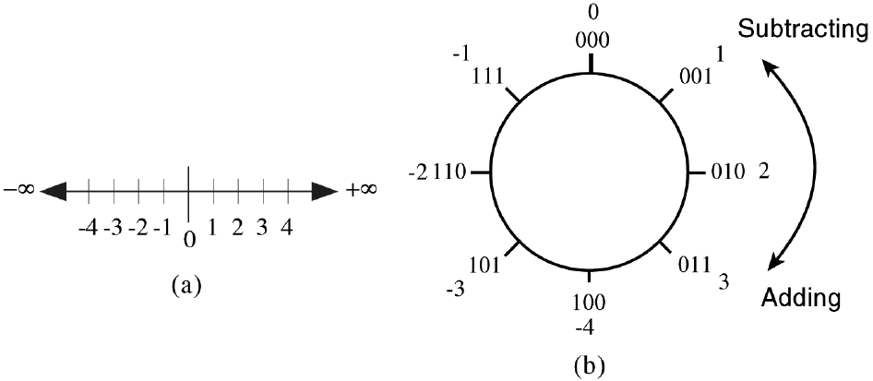
Binary Numbers can be Represented on a Number Circle
  • Numbers are added or subtracted on the number circle by traversing clockwise for addition and counterclockwise for subtraction.
  • Unlike the number line (a) where overflow never occurs, overflow occurs when a transition is made from
  +3 to -4 while proceeding around
  the number circle when adding,
  or from -4 to +3 while
  subtracting.

Slide 5
Overflow
  • Overflow occurs when the addition of two positive numbers produces a negative result, or when the addition of two negative numbers produces a positive result. Adding operands of unlike signs never produces an overflow.
  • Notice that discarding the carry out of the most significant bit during two’s complement addition is a normal occurrence, and does not by itself indicate overflow.
  • As an example of overflow, consider adding (80 + 80 = 160)₁₀, which produces a result of -96₁₀ in an 8-bit two’s complement format:
  01010000 = 80
  + 01010000 = 80
  ----------
  10100000 = -96 (not 160 because the sign bit is 1.)

Slide 6
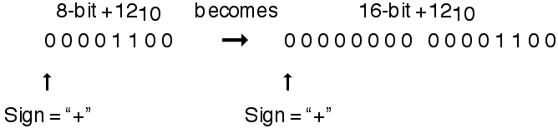
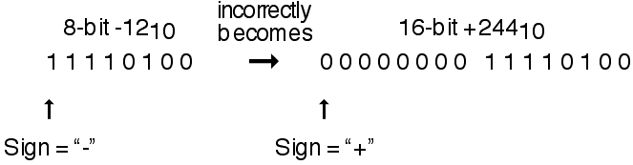
Sign Extension
  • The leftmost bit is assigned to the sign. What happens to the sign bit if we place a number into a larger or smaller word? For positive numbers, all that we need to do is pad the left side with 0s:
  • For negative numbers, we cannot simply pad the left side with 0s because that would change the value of the number:

Slide 7
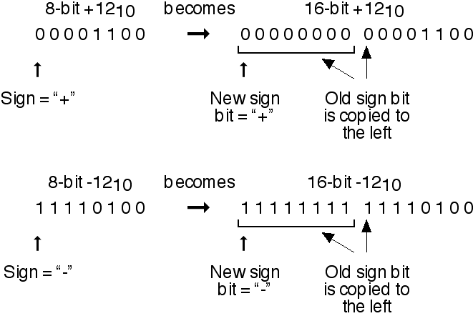
Sign Extension (continued)
  • As it turns out, all that we need to do is copy the sign bit for as many places as there are to the left and the number will be correctly extended, regardless of the value of the sign. This is known as sign extension:

Slide 8
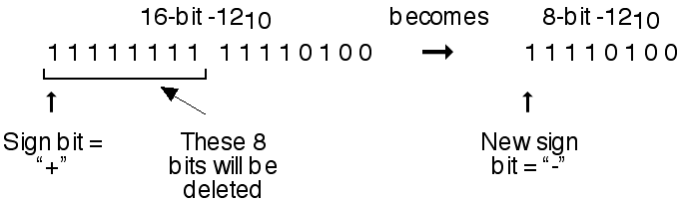
Sign Extension (continued)
  • If we want to reduce the size of the word, we can simply remove bits on the left and the resulting sign will be correct, as long as the number can be represented in the remaining bits:

Slide 9
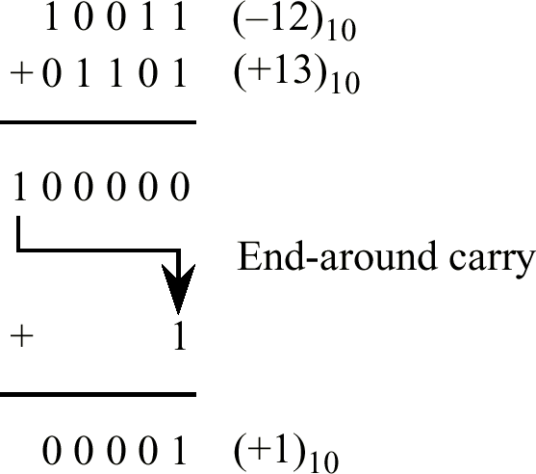
One’s Complement Addition
  • An example of one’s complement integer addition with an end-around carry:

Slide 10
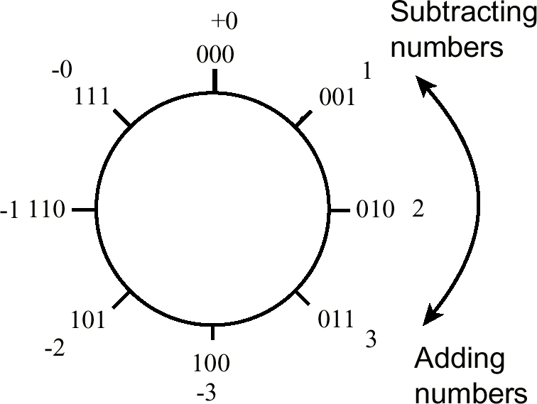
Number Circle (Revisited)
  • Number circle for a three-bit signed one’s complement representation. Notice the two representations for 0.

Slide 11
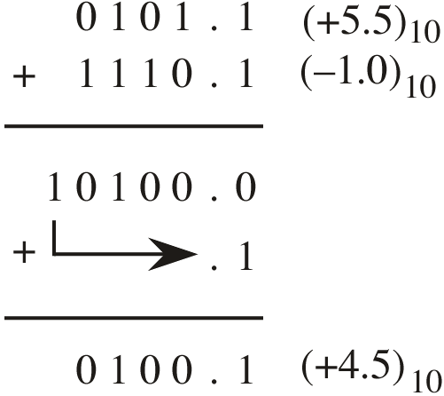
End-Around Carry for Fractions
  • The end-around carry complicates one’s complement addition for non-integers, and is generally not used for this situation.
  • The issue is that the distance between the two representations of 0 is 1.0, whereas the rightmost fraction position is less than 1.

Slide 12
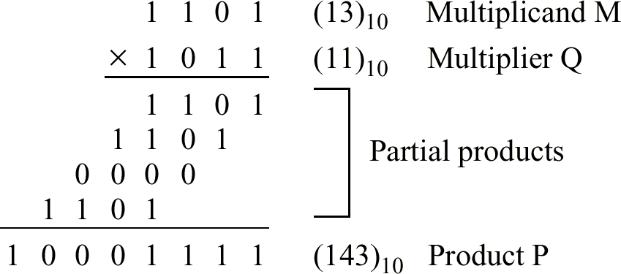
Multiplication Example
  • Multiplication of two 4-bit unsigned binary integers produces an 8-bit result.
  • Multiplication of two 4-bit signed binary integers produces only a 7-bit result (each operand reduces to a sign bit and a 3-bit magnitude for each operand, producing a sign-bit and a 6-bit result).

Slide 13
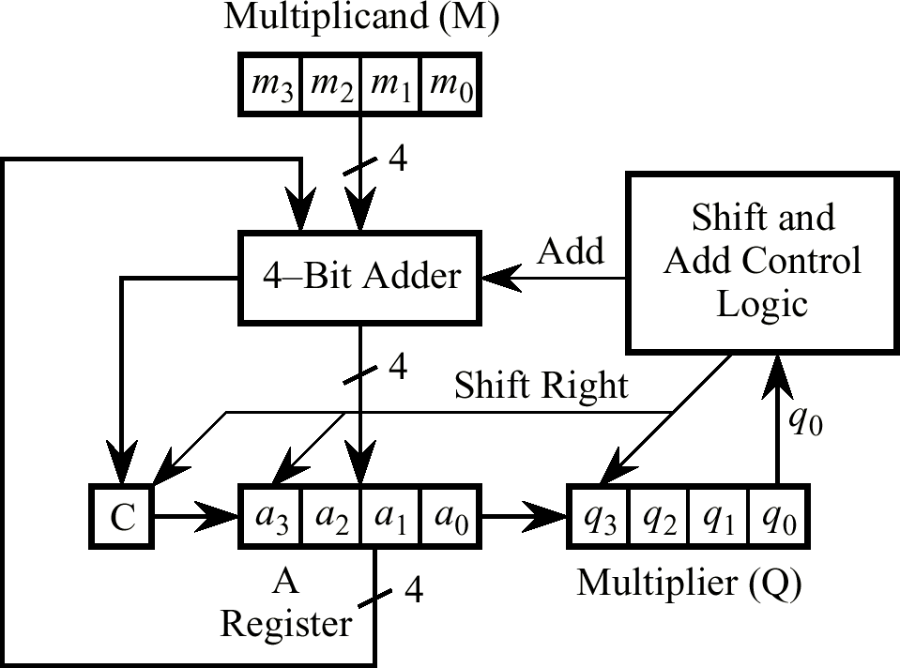
A Serial Multiplier

Slide 14
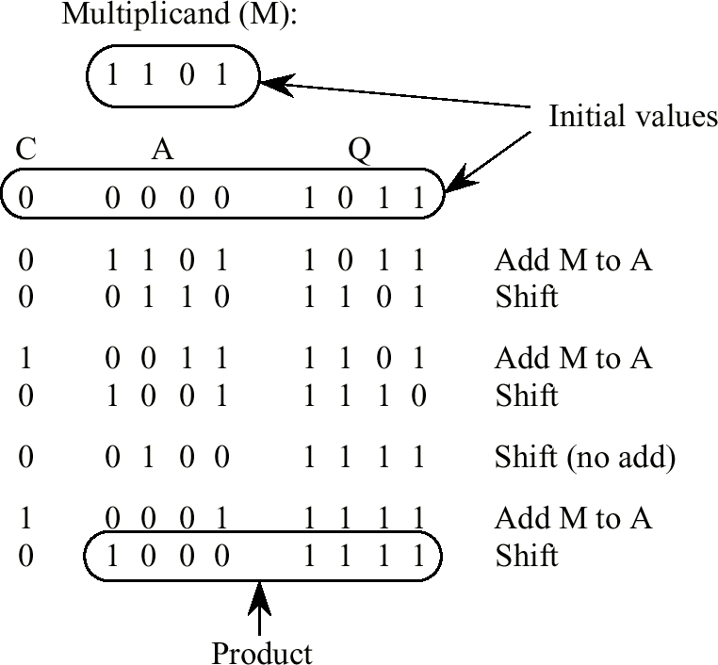
Example of Multiplication Using Serial Multiplier

Slide 15
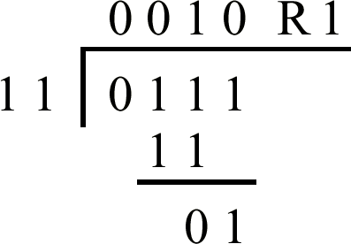
Example of Base 2 Division
  • (7 / 3 = 2)₁₀ with a remainder R of 1.
  • Equivalently, (0111/ 11 = 10)₂ with a remainder R of 1.

Slide 16
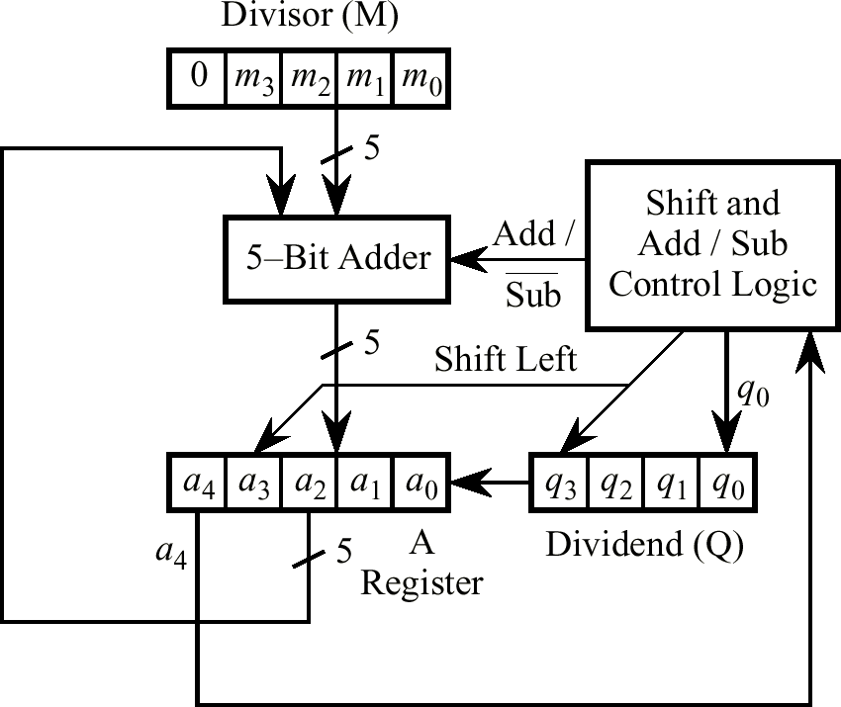
Serial Divider

Slide 17
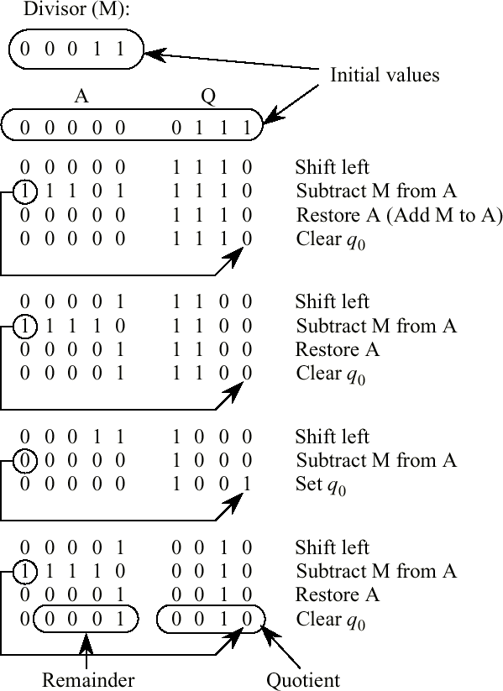
Division Example Using Serial Divider

